Slide 1
Unlocking Synergies: The IP-OS Best Practice Manual and Capacity Building Programme in 27 countries
Prof. Dr. Julia Priess-Buchheit / Marie Alavi M.A.
Tuesday, September 22th 2025

Slide 2
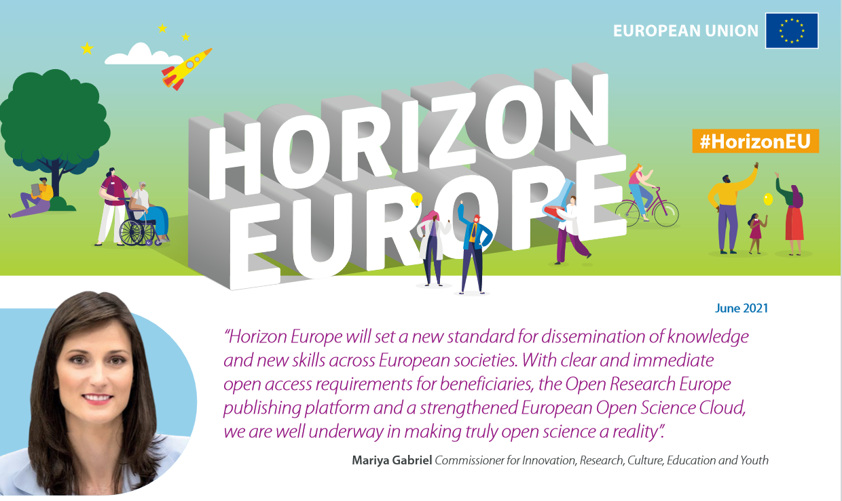
Why Open Science?
Reference:
European Commission: Directorate-General for Research and Innovation, Horizon Europe, open science – Early knowledge and data sharing, and open collaboration, Publications Office of the European Union, 2021.

Slide 3
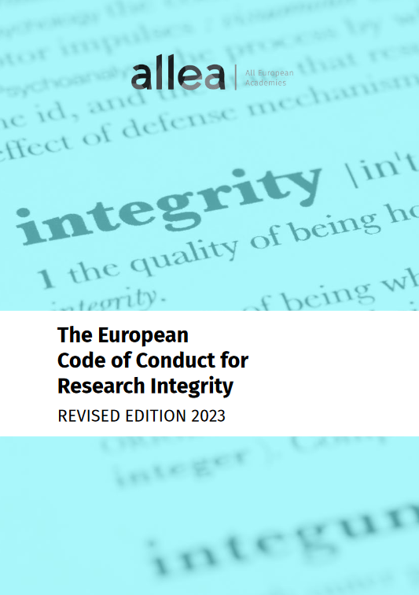
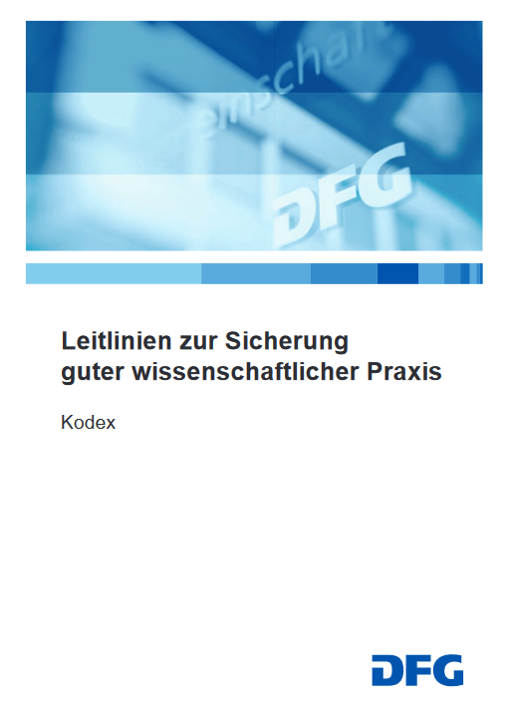
Why
Open Science?
Why? Opening the research process supports validation, reliability and reproducibility and reduces cases of academic misconduct. It helps to maximise the impact of your research and provides the foundations for others to build upon. In short, applying open science in your daily workflows is just part of good research practice!
(see What is Open Science? Foster Consortium 10.5281/zenodo.2629946)

Slide 4
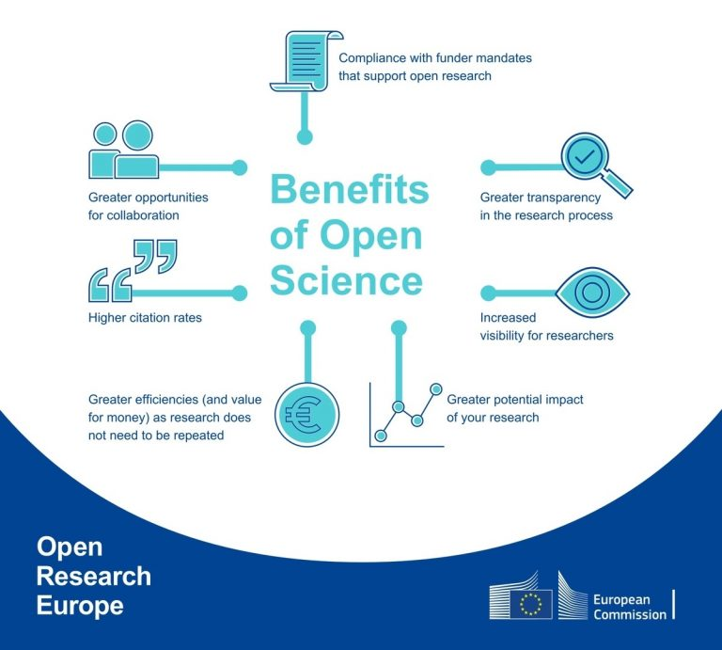
Why Open Science?

Slide 5
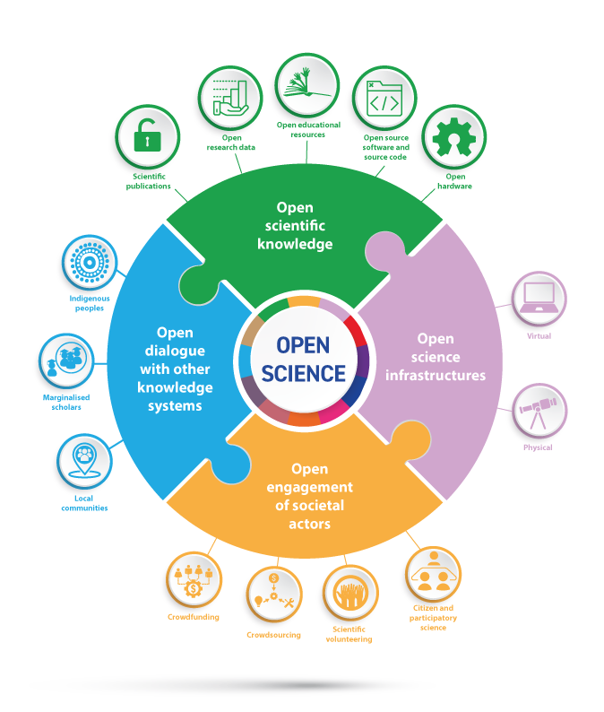
What is Open Science?
FOSTER defines Open Science (OS) as the practice of science so that others can collaborate and contribute, where research data, lab notes and other research processes are freely available under terms that enable reuse, redistribution and reproduction of the research and its underlying data and methods. (10.5281/zenodo.2629946)
Reference: "Understanding open science“ (2022).

Slide 6
Open Science – open access and more
A. Share your data - The research data that underpins publications should be accessible to support validation and facilitate reuse. In cases where data sensitivities won't allow open access, provide details on how someone could request authorised access.
B. Share your code - Many researchers now develop bespoke bits of code to help them analyse and/or visualise the data they have collected. Access to this code is essential for supporting the validation of your findings and helping others to build upon your work.
C. Share your workflows - Without knowing what steps were taken to capture, process and analyse the data - and in what order - it can be virtually impossible to validate published findings.
INTELLECTUAL ASSETS - Code of practice on the management of intellectual assets for knowledge valorisation

Slide 7
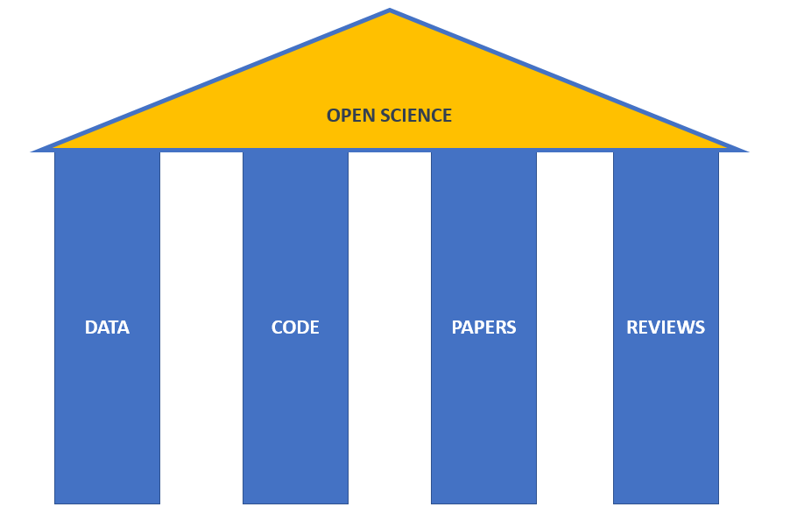
Four Pillars of Open Science
A: Open your Data and use DOI (Digital Object Identifiers) or PID (Persistent Identifiers)
B: Make sure that you use open-source standards to support
interoperability and their longer-term viability (e.g. with OSF, GitHub)
C: Use preprints and appropriate OA journals
or a discipline-specific repository.
D: Think about joining an open peer review.
(see: (https://doi.org/10.7287/peerj.preprints.2689v1)

Slide 8
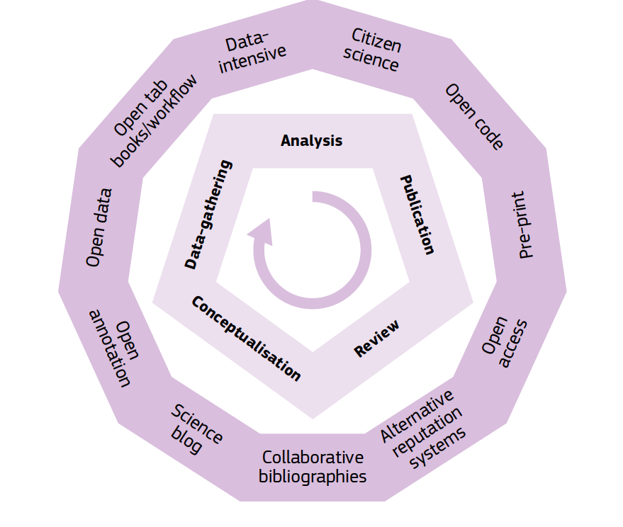
Open Science opportunities
in the research lifecycle
Reference: European Commission Public Consultation Science 2.0: Science in Transition

Slide 9
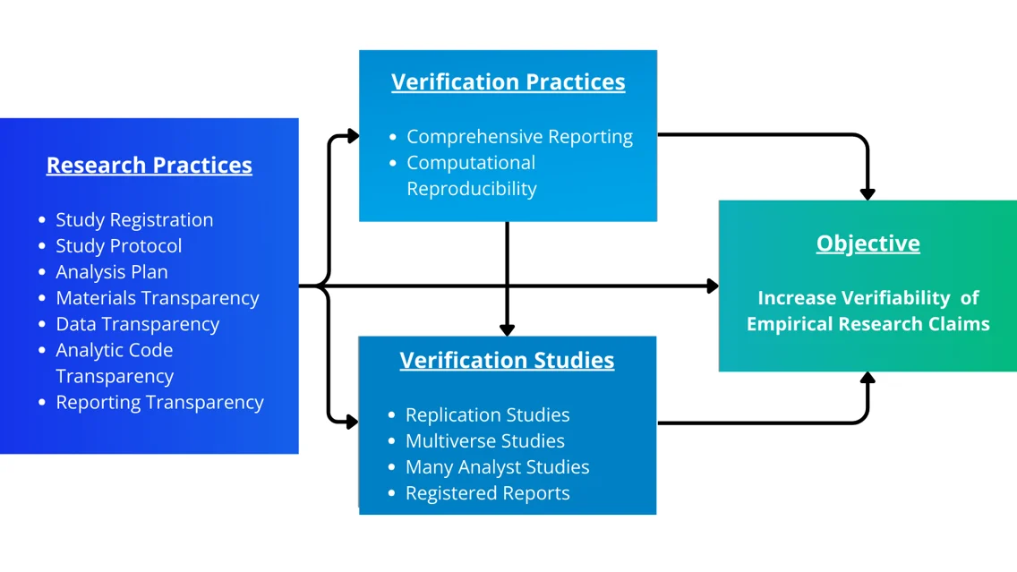
Exercise
European Commission Public Consultation Science 2.0: Science in Transition
https://www.cos.io/blog/new-preprint-introduces-major-update-to-the-top-guidelinesn
Discuss with your neighbour what Open Science Practices you already know. What is unknown to you? Look it up together if you have never heard the word.
TIME: 5 minutes!

Slide 10
Towards Knowledge Valorisation
turns research outputs (results, data, software, code etc.) into sustainable products and solutions – economic or environmental benefits, social progress or improved policy making.

Slide 11
The interplay of Open Science and Intellectual Property

Slide 12
Typical
Intellectual Property Rights
Trade Secrets
Copyright
Patent
Trademarks
Regulatory Exclusivity

Slide 13
Intellectual Property Rights
“Intellectual property rights are the rights given to persons over the creations of their minds.
Intellectual property rights usually give the creator an exclusive right over the use of his/her creation for a certain period of time” (see World Trade Organisation).
Trade Secrets
Copyright
Patent
Trademarks
Regulatory Exclusivity

Slide 14
Definitions in the European Union Code of Practice 2023
Intellectual property means the result of intellectual activities that is eligible for legal protection and includes inventions, literary and artistic works, symbols, names, images, and designs;
intellectual property rights include patents, trademarks, designs, copyright and neighbouring rights, geographical indications and plant variety rights, as well as trade secret protection rules;
intellectual asset means any result or products generated by any R&I activities (such as intellectual property rights, data, know-how, prototypes, processes, practices, technologies, and software);
Trade Secrets
Copyright
Patent
Trademarks
Regulatory Exclusivity

Slide 15
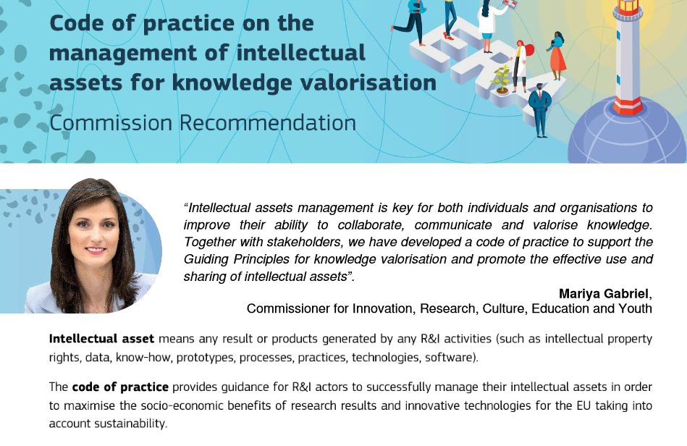
Copyright
Patent
Trademarks

Slide 16
Recommendations in the Code of Practice 2023
It is recommended to define and adopt strategic intellectual assets management practice
It is encouraged that intellectual assets are managed in a way to enable open science and open innovation
It is recommended to invest in education, training and awareness raising
It is recommended to clarify ownership of intellectual assets as early as possible
It is recommended to establish clear collaboration conditions
--- and more
Trade Secrets
Copyright
Patent
Trademarks
Regulatory Exclusivity

Slide 17
How intellectual assets management and open science practices intersect
To examples …
Copyright and Licensing
Regulatory Exclusivity
Trade Secrets
Patent
Trademarks

Slide 18
How intellectual assets management and open science practices intersect
To examples …
Copyright and Licensing
Regulatory Exclusivity
more examples
Trade Secrets
Patent
Trademarks

Slide 19
A Guide to Build Capacity for Knowledge Valorisation in Europe
Integrating Intellectual Property (IP) and Open Science (OS) for Sustainable Impact

Slide 20
Knowledge Valorisation
Knowledge valorisation creates social and economic value from research knowledge.
Activities: trustworthy research, knowledge transfer, innovation support, academia-industry collaboration.
Importance: strengthens EU competitiveness, supports sustainable growth, and addresses societal challenges.
IP & OS are key enablers: IP protects and enables innovation, OS ensures transparency and reuse.

Slide 21
Status Quo in Europe (Stakeholders’ perceptions of the synergy between intellectual property and open science: A cross-sectional survey, 2025)
IP and OS often treated in parallel, not integrated.
56% researchers familiar with OS, but only 11.9% confident using IP with OS.
Barriers: lack of institutional guidance, open licensing awareness, legal differences.
Challenges: misaligned goals, licensing complexity, insufficient training.

Slide 22
Target Groups for Improvement
Group A: IP experts & intermediaries – Provide tools, frameworks, ensure compliance.
Group B: Researchers – Primary decision-makers on IP and OS.
Group C: Trainers & multipliers – Build sustainable knowledge through training.

Slide 23
IP & OS: A Complex System Made Easy
Time – When to apply IPRs.
Level of Reuse – Align openness with needs.
Producing vs. Using – Plan accordingly for protection or reuse.

Slide 24
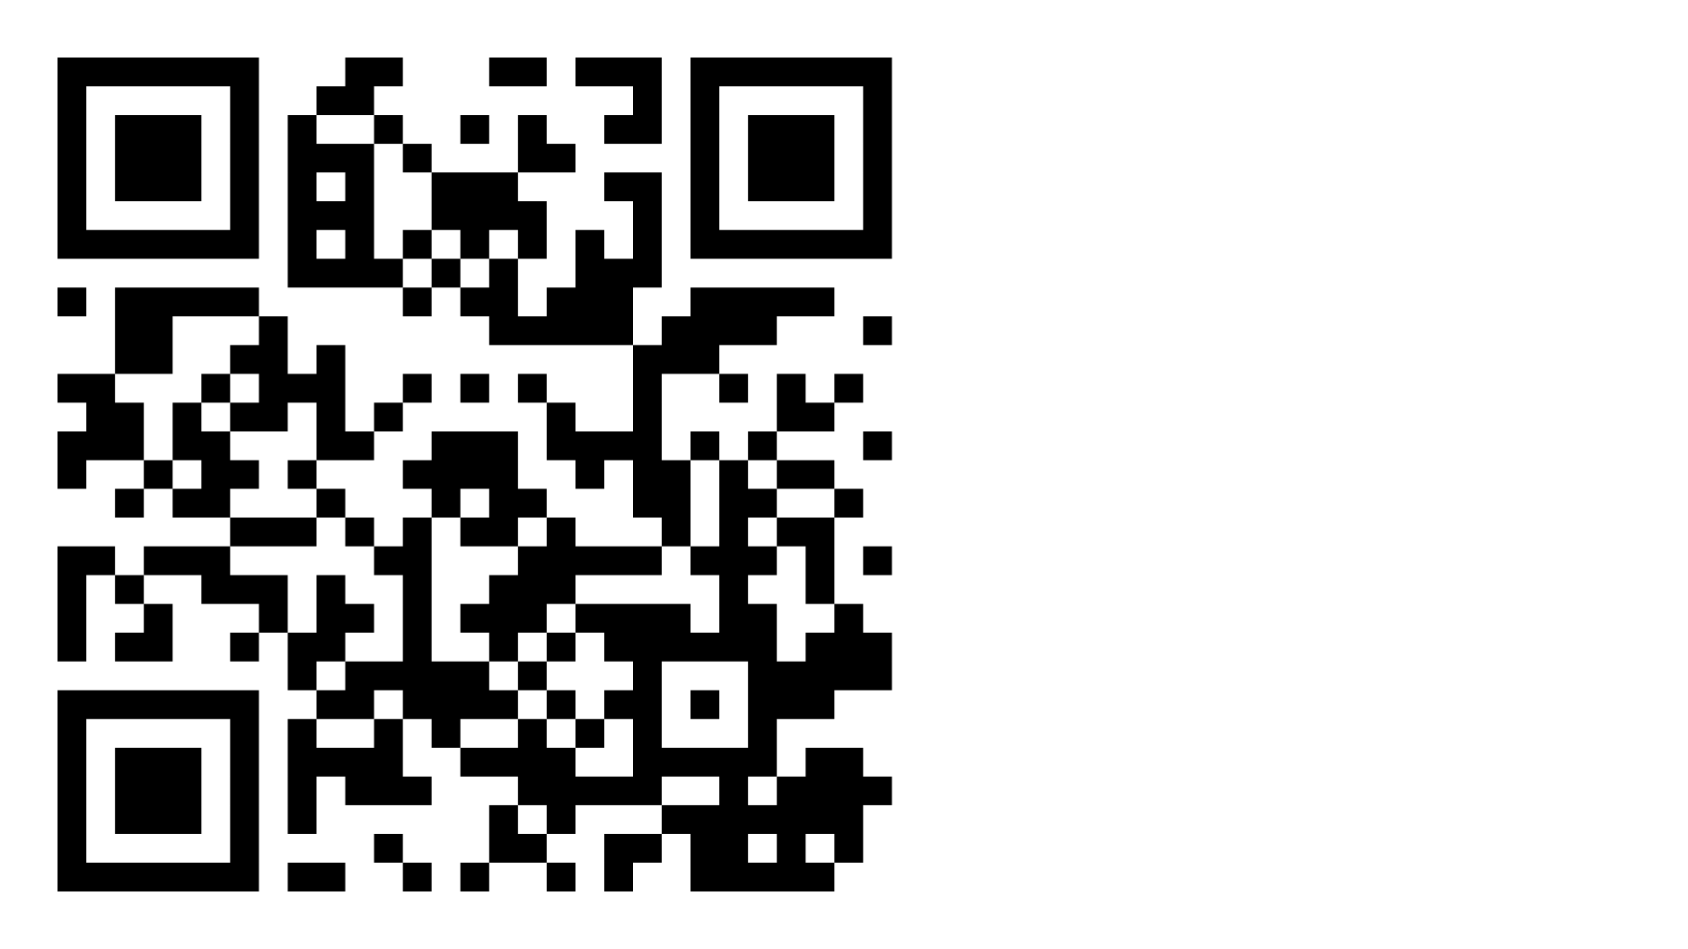
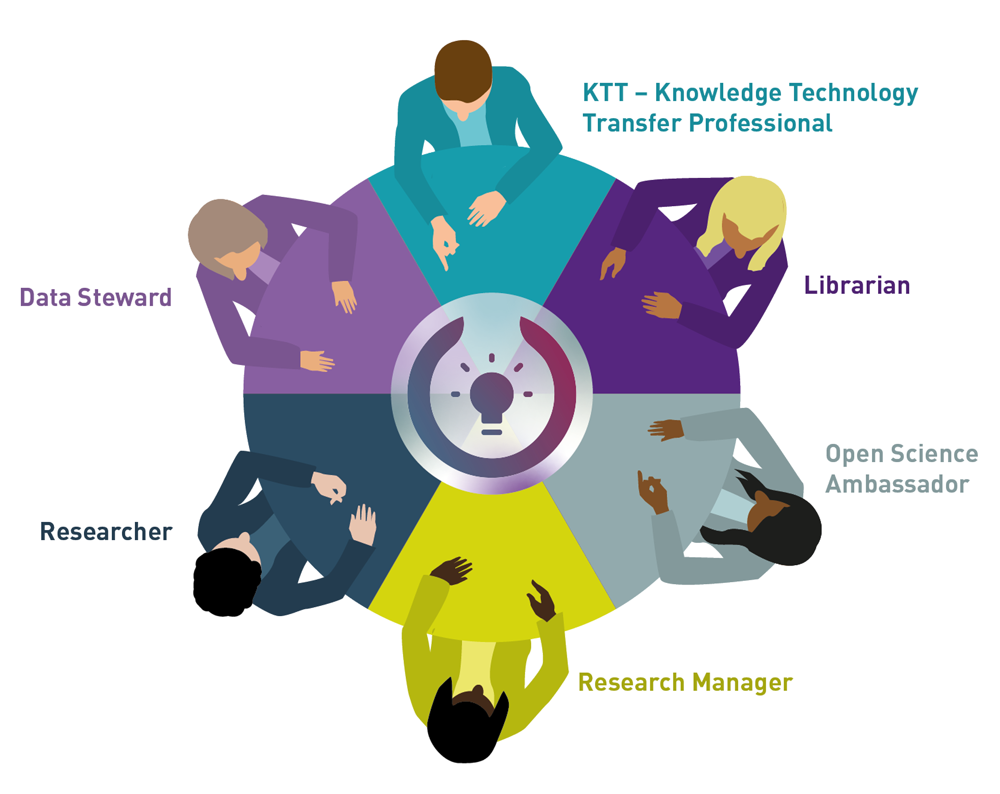
We already established multi-professional teams in 22 EU countries. Do you want to join?

